Slide 1
ZOMATO ANALYSIS
Team Members: Avala Sai Kiran, Neha Devarashetty, Pannerselvam Rahul kumar, Shaik.Ameer shareef, Chanjal CM, Rohit Appasaheb Anap, D.Mohan kali prasad, Pepakayala santhosh

Slide 2
INTRODUCTION
This project analyzes the dataset of Zomato to understand restaurant trends, customer preferences, and business insights.
The dataset includes details like restaurant names, locations, cuisines, ratings, cost, and online delivery options.
The main goal is to extract meaningful insights that can help improve business decisions and customer experience.

Slide 3
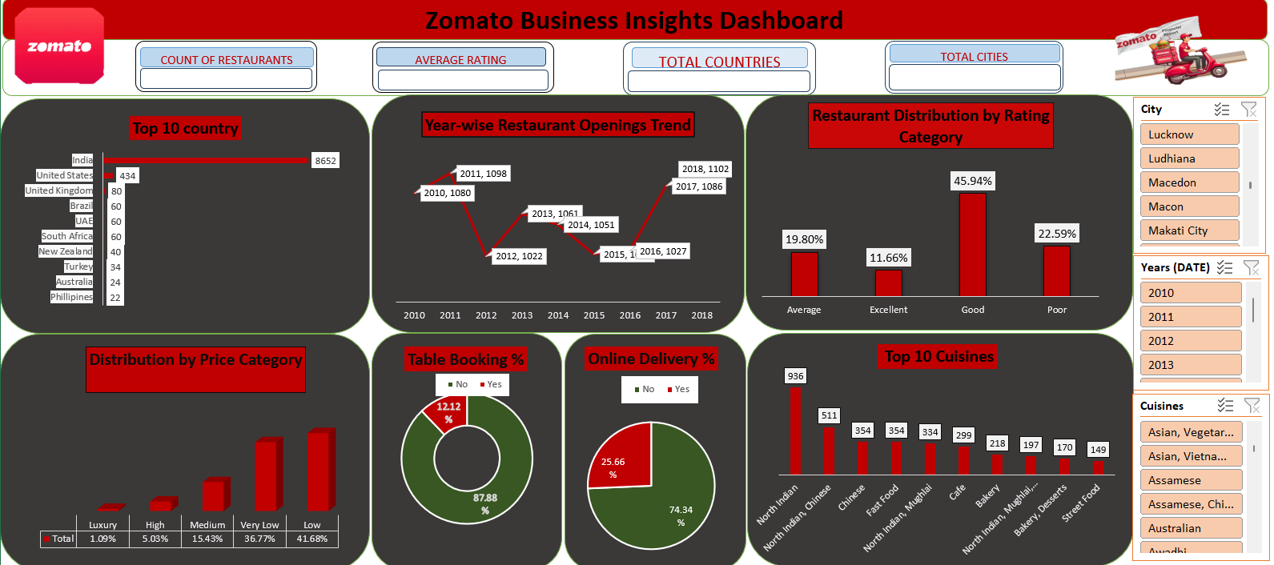
EXCEL DASHBOARD

Slide 4
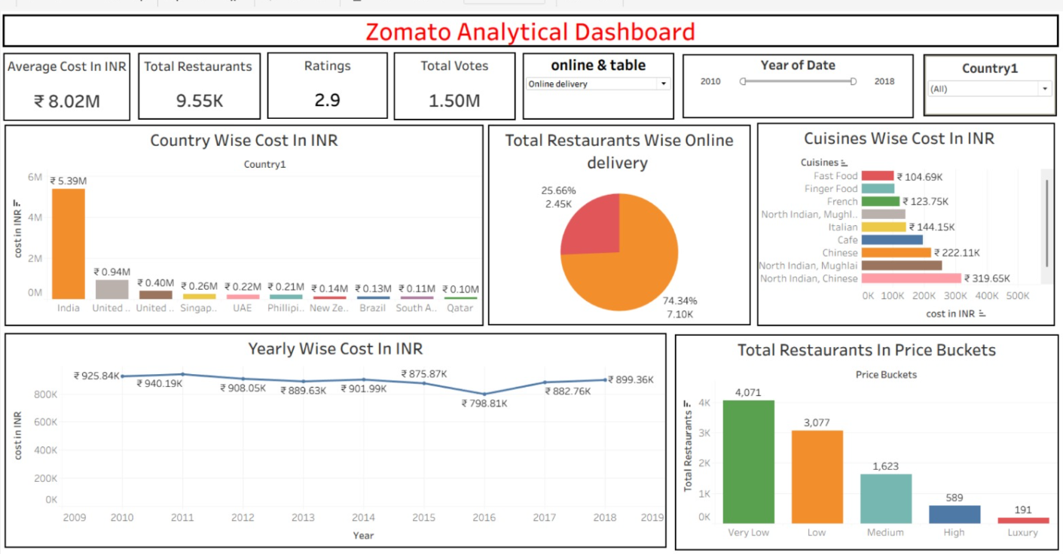
TABLEAU DASHBOARD

Slide 5
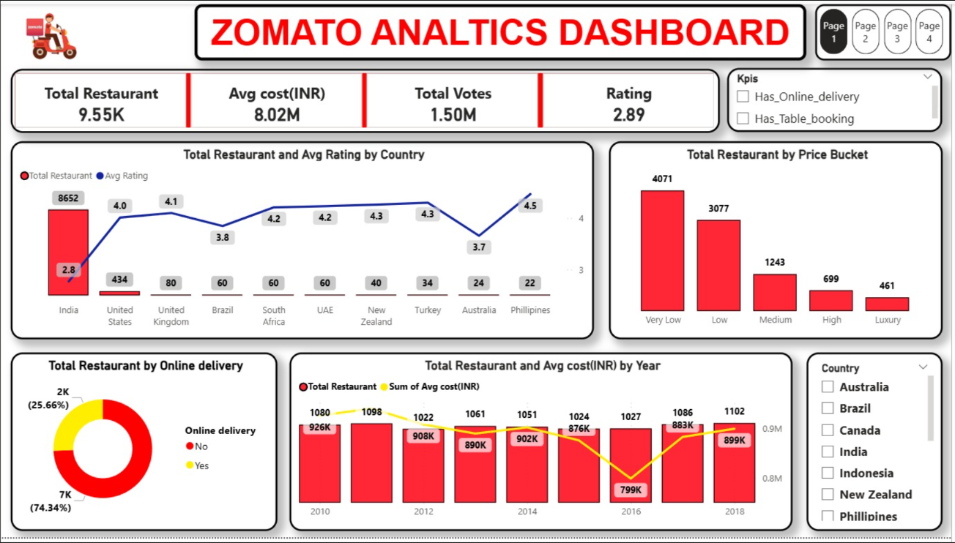
POWERBI DASHBOARD

Slide 6


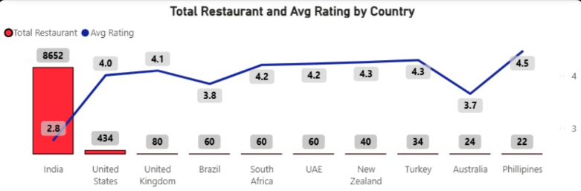

India has the highest number of restaurants (~8652).
Other countries have significantly fewer restaurants.
Ratings are higher in countries like Philippines (~4.5) compared to India (~2.8).

Slide 7
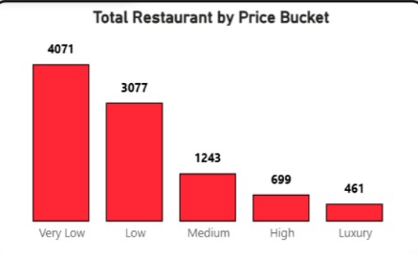
Majority of restaurants fall under “Very Low” (4071) and “Low” (3077).
Medium and High categories have fewer restaurants.
Luxury category has the least number of restaurants.

Slide 8
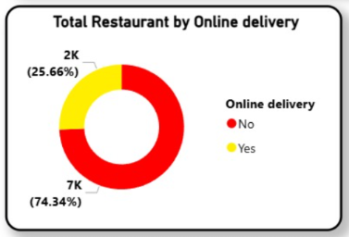
Around 74.34% of restaurants do not offer online delivery.
Only 25.66% provide delivery services.

Slide 9
INSIGHTS
Most restaurants are concentrated in metro cities like Delhi NCR, Mumbai, and Bangalore.
Online delivery is offered by a large number of restaurants, showing high demand for convenience.
Restaurants with higher ratings generally have moderate pricing, not the most expensive ones.

Slide 10
INSIGHTS
Certain cuisines like North Indian, Chinese, and Fast Food are the most popular.
A large number of restaurants fall in the average rating category (3.0 – 4.0).
Some cities have high restaurant density but low average ratings, indicating quality issues.

Slide 11
OUTCOMES
India has the highest number of restaurants but lower ratings.
Most restaurants are in low price range.
Many restaurants do not offer online delivery.
Costs are mostly stable over the years.
Ratings are better in some other countries.

Slide 12
RECOMMENDATIONS
Restaurants should focus on improving quality to increase ratings.
Expand online delivery services in areas where it is less available.
Introduce popular cuisines in regions where demand is high but supply is low.
Maintain competitive pricing instead of high pricing for better ratings.
Use customer feedback data to improve services.

Slide 13
CONCLUSION
The analysis of the Zomato dataset provides valuable insights into restaurant trends and customer behavior.
It helps businesses understand market demand and improve their services.
Data-driven decisions can significantly enhance customer satisfaction and profitability.
Overall, this project demonstrates the importance of data analysis in the food industry.

Slide 14
THANK YOU.

